Slide 1
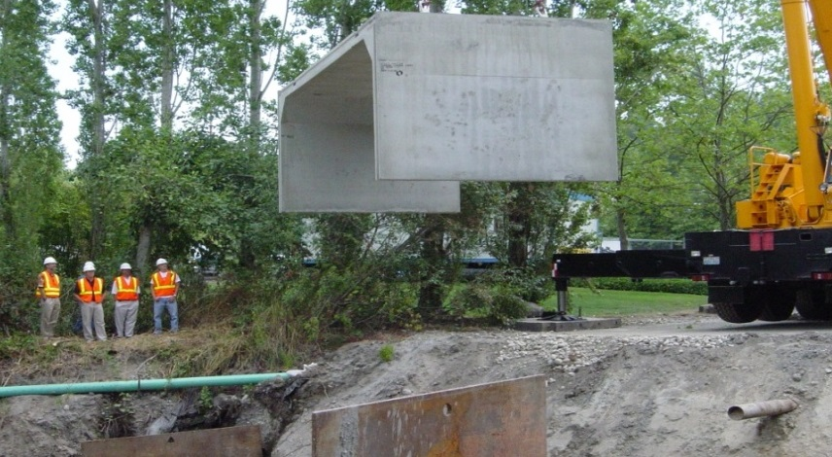
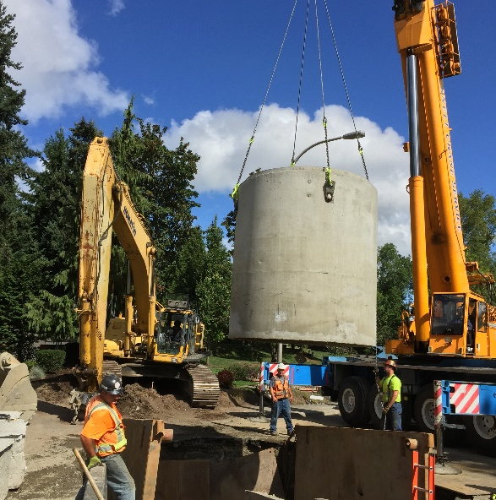
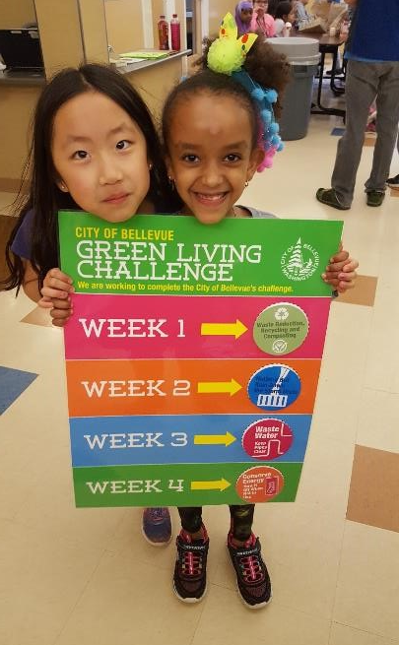
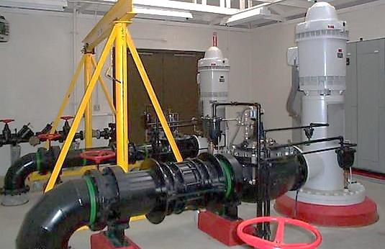
City of Bellevue
Utilities Department
Neighborhood Leadership Gathering
September 2018
Nav Otal, Director

Slide 2
“Invisible Systems, Visible Benefits”
Neighborhood Leadership Gathering
Delivering daily essential services:
Water – a life critical resource
Wastewater – protecting public health
Storm & Surface Water – protecting the environment
Solid Waste Services – encouraging sustainability
in a manner that is environmentally responsible and cost-competitive

Slide 3
Bellevue Utilities
Neighborhood Leadership Gathering
Unique among city departments:
Out of sight, out of mind
Each utility independent
Rates are primary source of revenue
Utility business is capital intensive
Services are not scalable
Service vs. commodity

Slide 4
Neighborhood Leadership Gathering
Text the word “utilities” to 22333.

Slide 5
Neighborhood Leadership Gathering
2018 Utilities Budgeted Expenses
$144.3M
28%
Renewing & Replacing Infrastructure
Taxes/
Interfunds
$19.4M
Capital Investments
$41.0M
53%
Financial Obligations
Taxes/Support Services
Purchased Water
Wastewater Treatment
Local
Operations
$27.9M
Wholesale
$56.0M
19%
Maintaining and Operating the Utility

Slide 6
Neighborhood Leadership Gathering

Slide 7
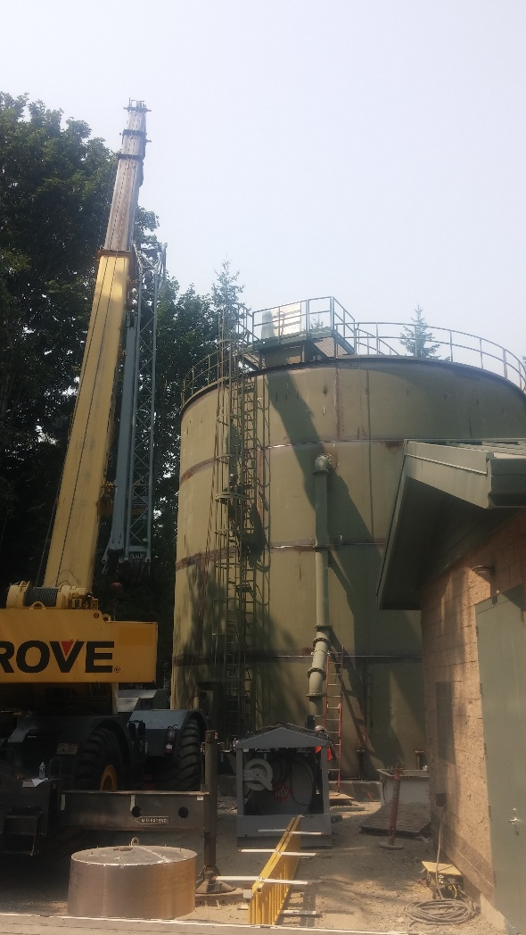
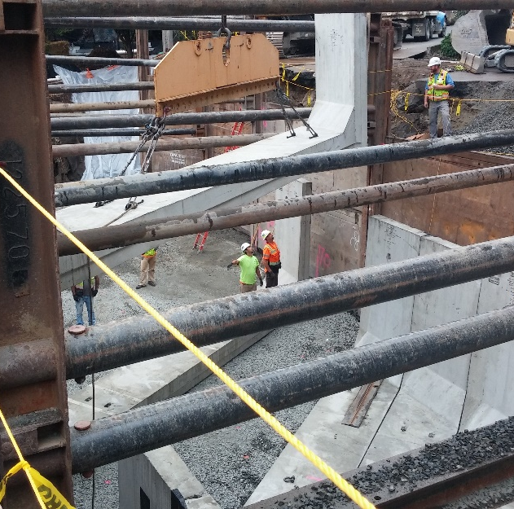
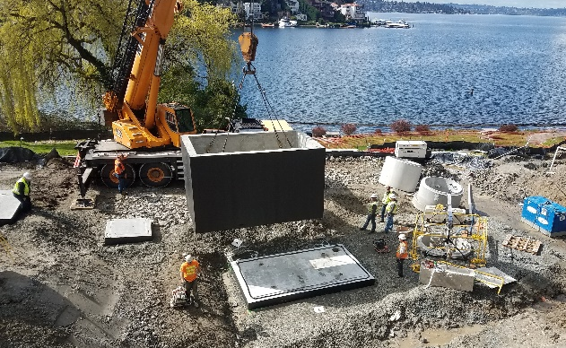
Managing Aging Infrastructure
Neighborhood Leadership Gathering
Not too soon. Not too late.

Slide 8
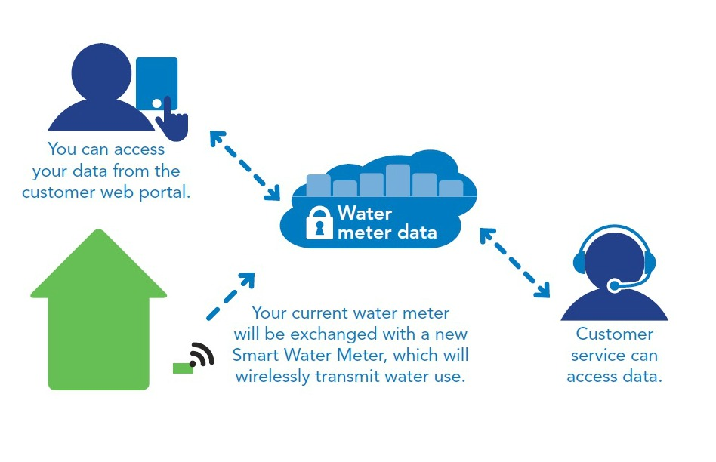
Investing in the Future Smart Water Meters Coming to Bellevue
Neighborhood Leadership Gathering

Slide 9
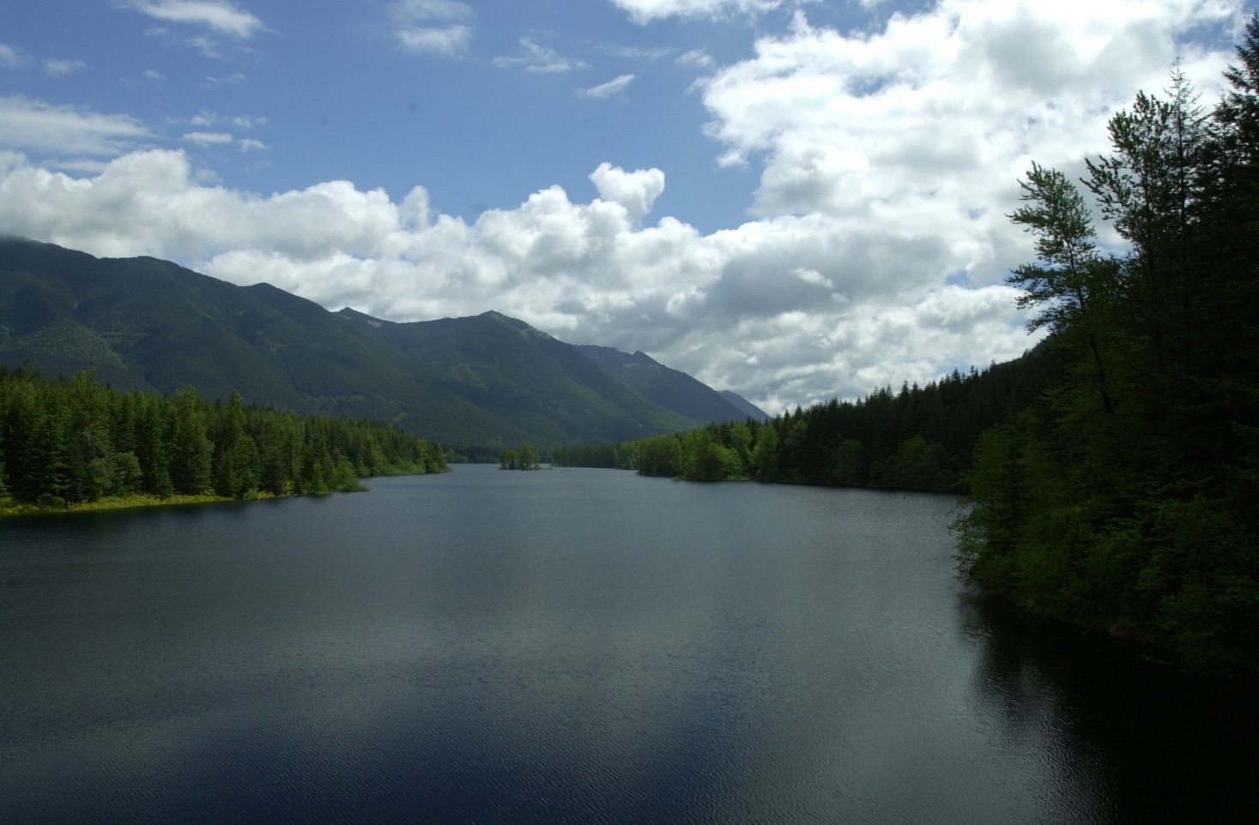
Water Is Life
Neighborhood Leadership Gathering
We have some of the best water in the country
The Cedar River Watershed in the Cascade Mountains – protected from human activity and development.

Slide 10
Stewards of Customer Dollars
Neighborhood Leadership Gathering
Our methodology for determining rates is rigorous
Setting rates is a collaborative process that involves:
- Cross Departmental Team from the City
- City Leadership Team
- Environmental Services Commission
- City Council
Rates are designed to fully fund our operating and capital expenses now and into the future.

Slide 11
Utility Services for Dollars a Day
Neighborhood Leadership Gathering
Single-family residents of Bellevue get:
Safe, reliable drinking water
Safe removal of wastewater from the home
Flood protection during storms
Healthy streams, lakes, and wetlands

Slide 12
Neighborhood Leadership Gathering

Slide 13
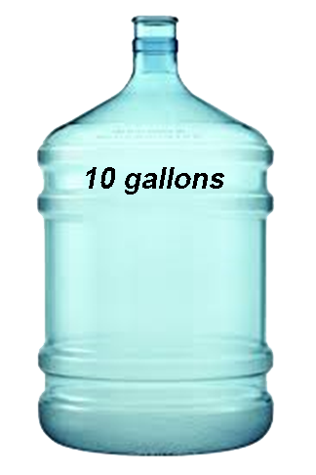
Neighborhood Leadership Gathering
High-Quality Drinking Water
for a penny a gallon
100-gallons of Mountain Fresh
$1 Retail

Slide 14
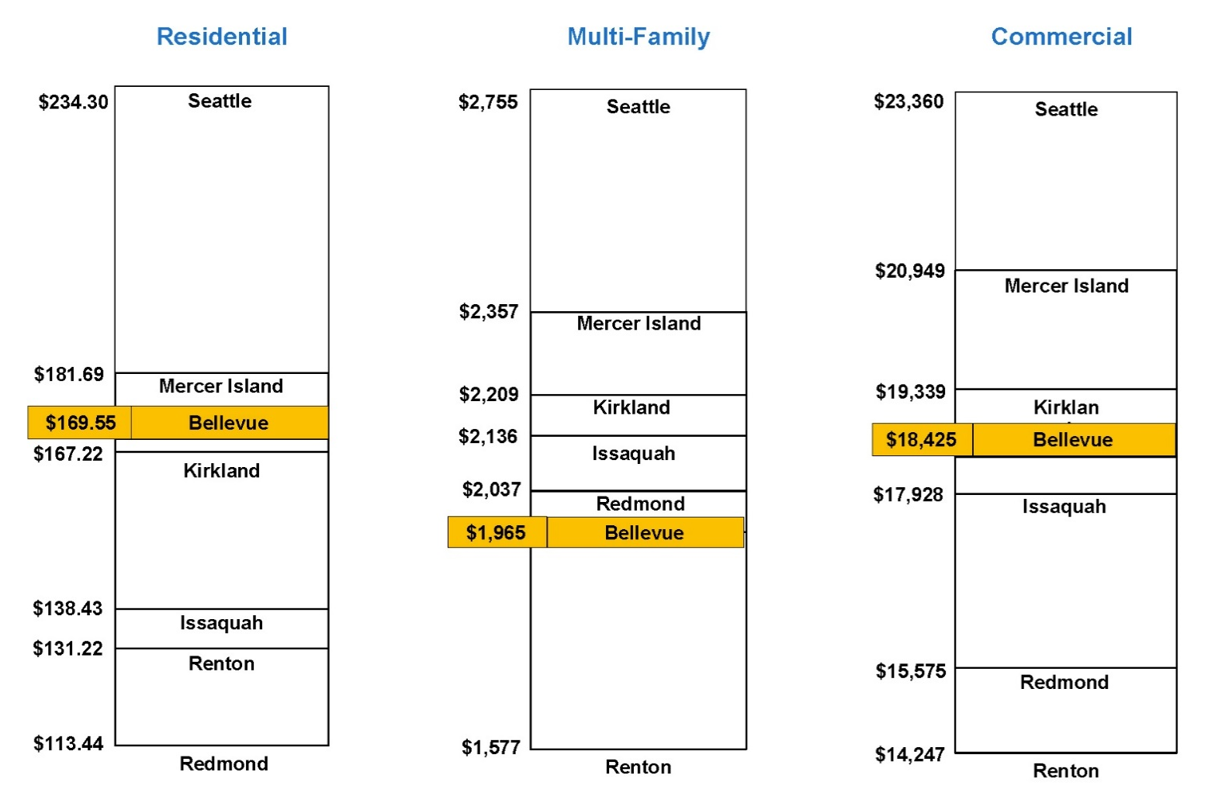
Our Rates Are Competitive
Neighborhood Leadership Gathering
Assumptions:
Water: ¾ inch water meter; 8.5ccf consumption/month
Sewer: 7.5ccf wastewater flow/month
Storm: 10,000sft lot at moderate development level

Slide 15
Serving All Our Residents
Neighborhood Leadership Gathering
Our Utility Rate and Tax Relief Programs recognize that some residents need help with their utility bill.
Utility Rate Relief The city offers low–income seniors (62 and older) and low–income permanently disabled persons relief on their utility costs for water, wastewater, drainage, and solid waste.
Utility Tax Relief Bellevue’s Tax Relief Program offers a year-end rebate check for a portion of the Utility Occupation Taxes paid to the city.

Slide 16
A Well-Managed Utility
Neighborhood Leadership Gathering
High Customer Satisfaction Rating
87% Customer Satisfaction
Competitive Rates
Solid Financial Management
No Debt
High Bond Rating – Aa1
National Standards of Excellence
APWA Accreditation
AMWA Platinum Award
AMWA Sustainability Award

Slide 17
Neighborhood Leadership Gathering
Up Next: Tours
Water Operations
Wastewater Operations
Stormwater Operations
Stormwater Education
Solid Waste Programs
Construction Program
Utility System Operations

Slide 18
Thank you! Questions?
Neighborhood Leadership Gathering

