Slide 1
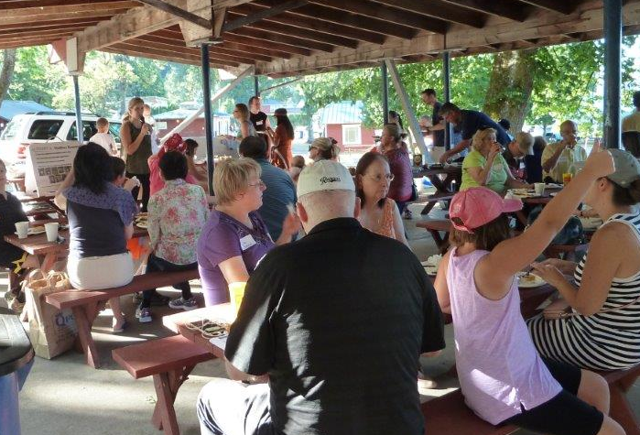
Initiating Neighborhood Area Planning June 12, 2018

Slide 2
Tonight’s Agenda
6:00 Welcome
6:10 Neighborhood Area Plan Maps
6:40 Overview of proposed process
7:15 Discussion: feedback and suggestions
7:55 Wrap up and next steps

Slide 3
Neighborhood Area Maps
What is one thing makes your neighborhood unique and distinctive?
What one thing do you like to do in your neighborhood?
What one emerging issue do you see in the future for your neighborhood?

Slide 4
Initiating Neighborhood Area Planning June 12, 2018
Terry Cullen, Deborah Munkberg

Slide 5
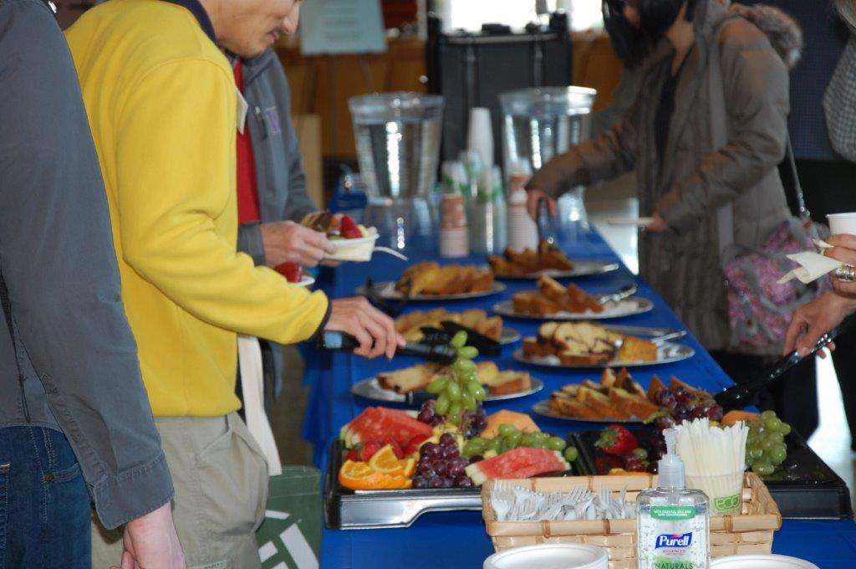
Neighborhood plans:
will be organic, fun and informative
Notes:
Organic – activities will arise out of neighborhood interests; have a public engagement program with a menu of possible activities, but want what we are doing reflect and be tailored to neighborhood interests and needs
Include food, activities to build meaningful conversation and connections, at to provide creative thought and ideas
Informative – we know that city staff will learn a lot as we spend time in the neighborhoods, and we also want to be sure to provide a program that is informative and helpful for the people who participate

Slide 6
Neighborhood plans:
depend on a collaborative relationship between the city and residents
Notes:
We cannot and do not want to create a neighborhood plan from city hall
We will be working in partnership with the neighborhood

Slide 7
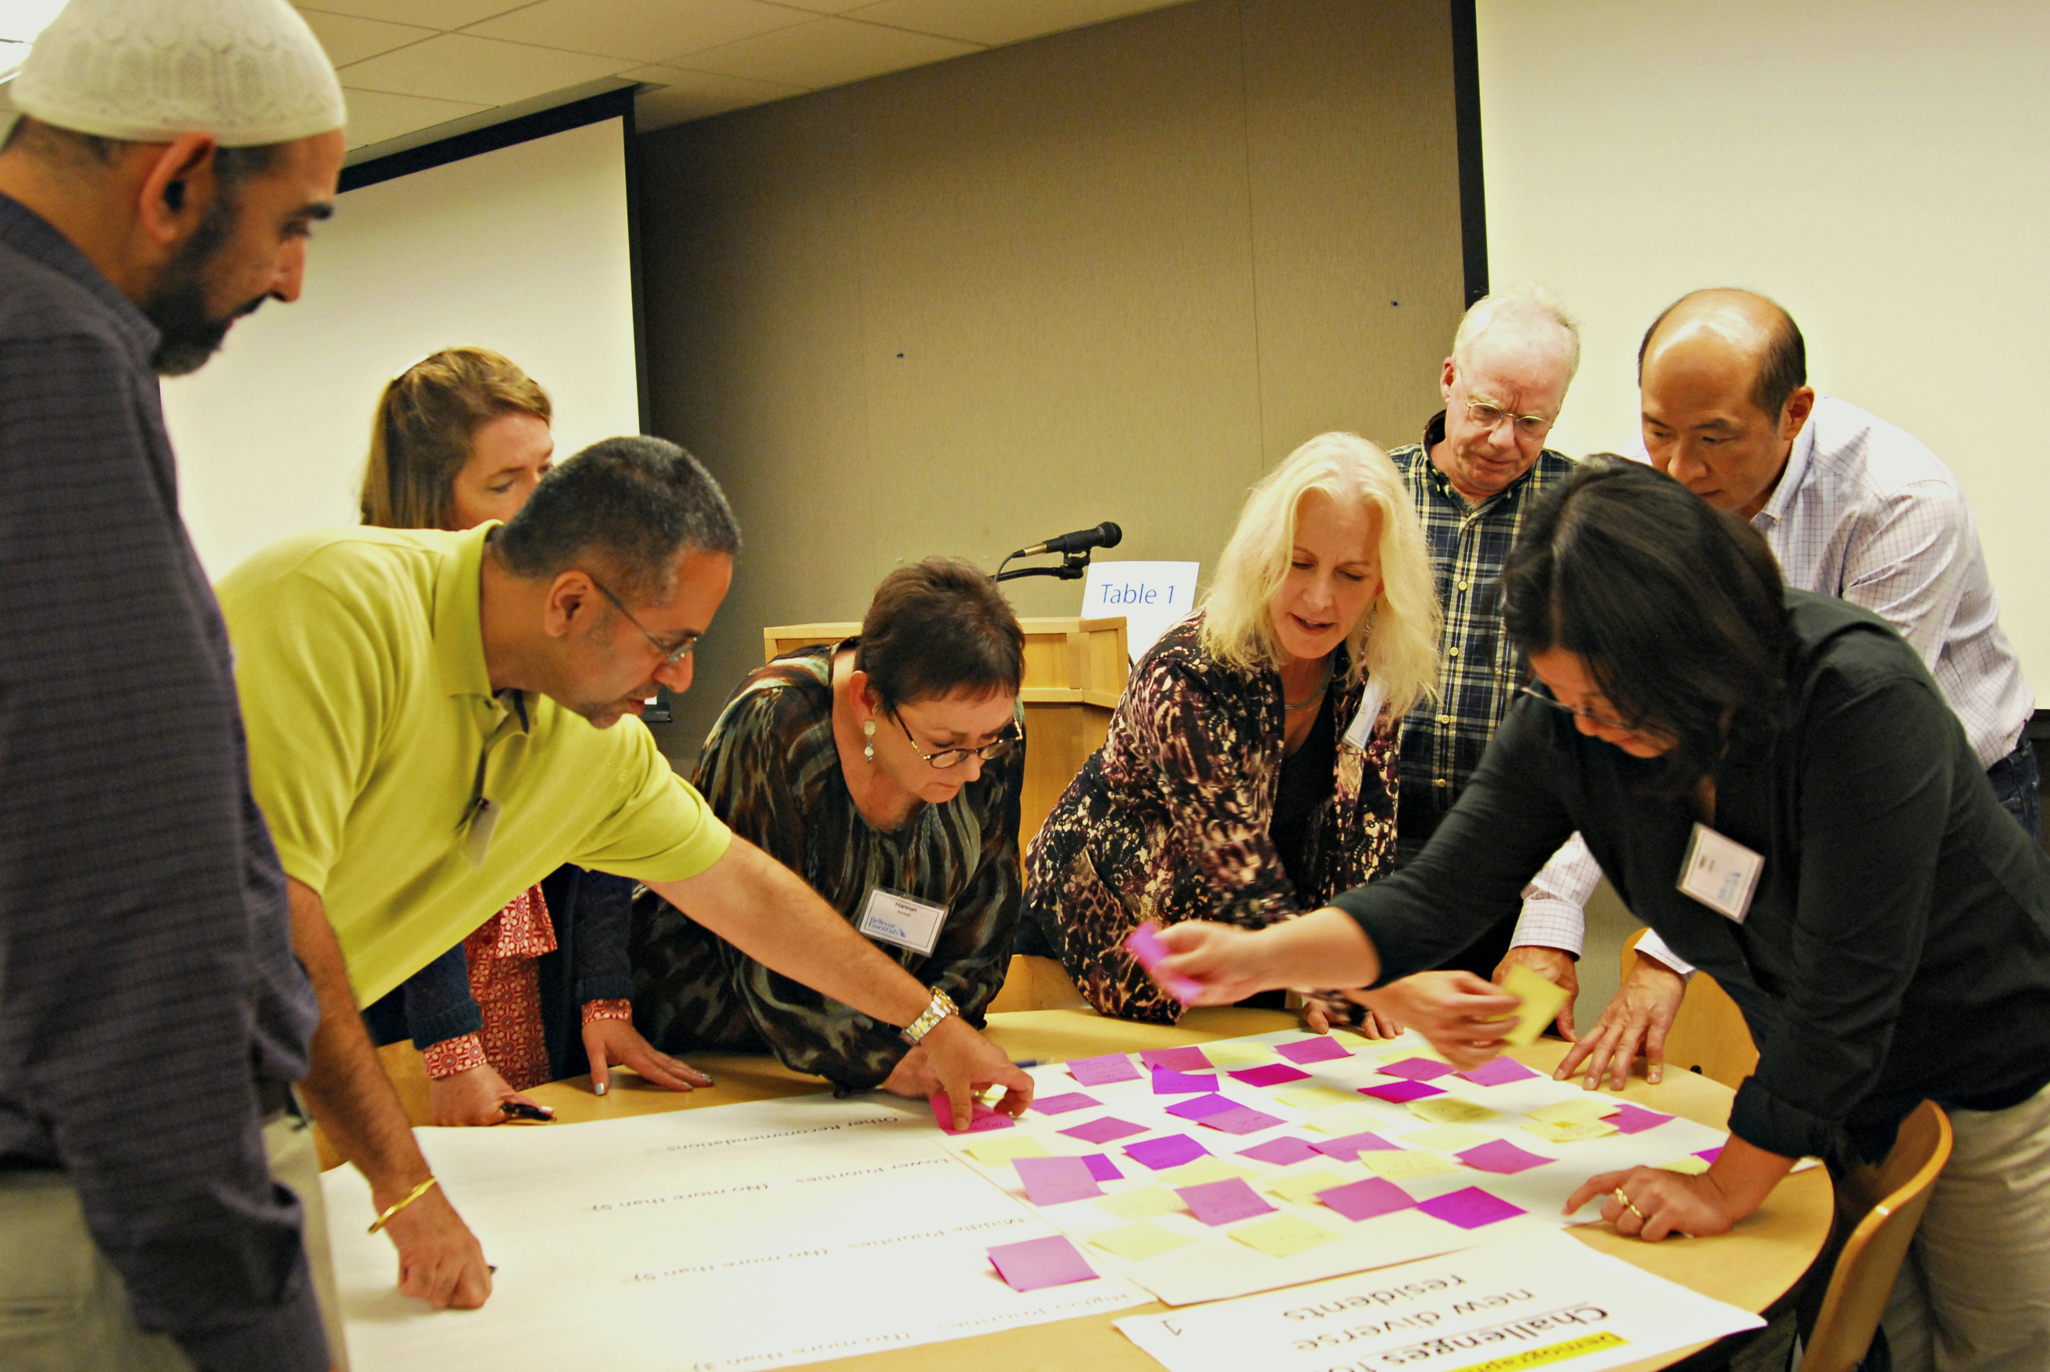
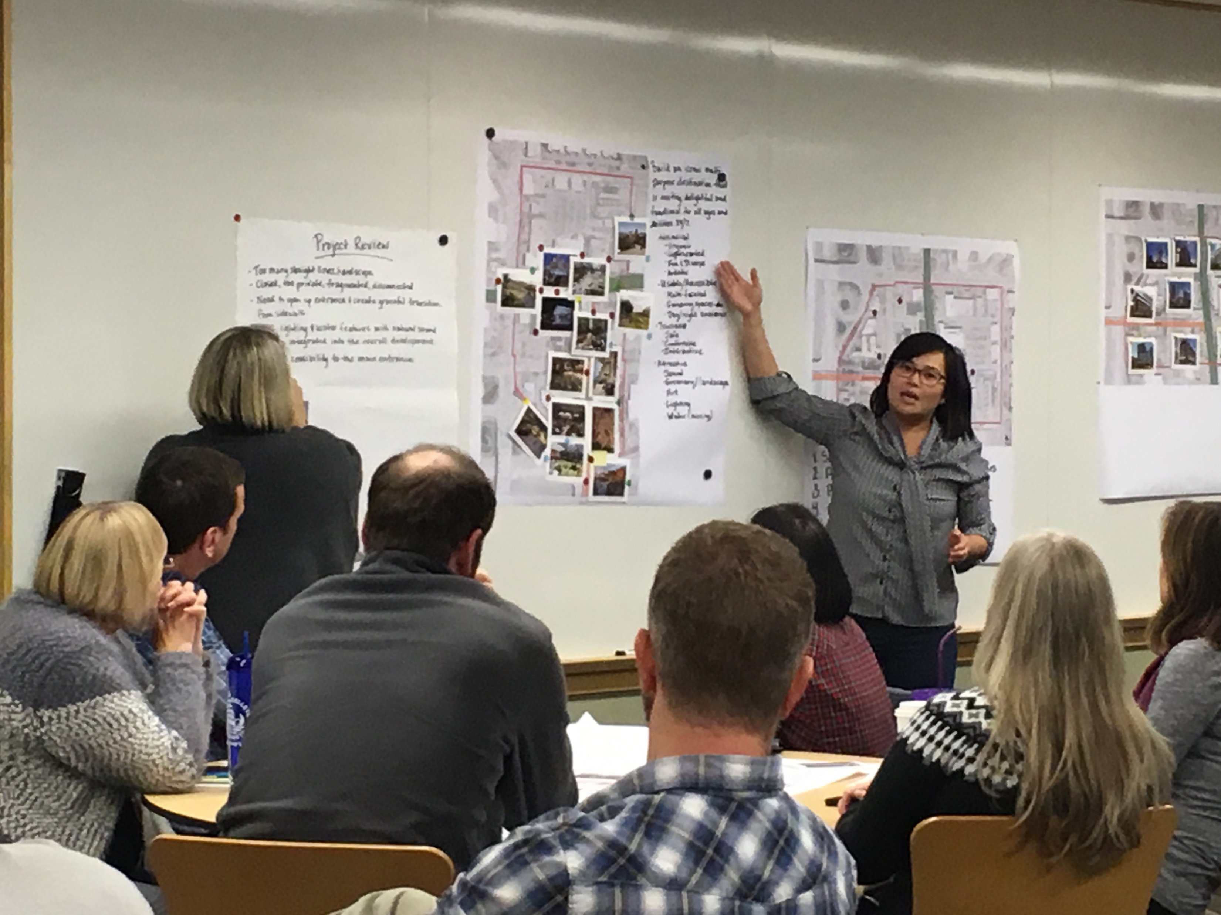
Neighborhood Engagement
Grass roots
Neighborhood associations, community groups, faith networks, business, schools
In person, In neighborhood
Neighborhood workshops
Trained citizen facilitators
Emphasis on participatory activities
Online engagement
surveys, forums, maps
Notes:
Historically under-represented – multifamily residents, new residents, families with young children, young adults, speakers of English as a second language
People who are and have been active – insights and knowledge
Flexible communication – online and in person opportunities at different times of day and in different formats
Citizen facilitators
Recommendations of the whole
Examples – meetings, interactive online engagement, small group meetings, youth and school involvement, walking tours, photography, story telling, artist supported activities, and other ideas that come from the neighborhood

Slide 8
Neighborhood plans:
will be strategic and future-focused
Notes:
Arise from identified interests and priorities of the neighborhood area
Will include a vision for the future
Will include strategies and actions

Slide 9
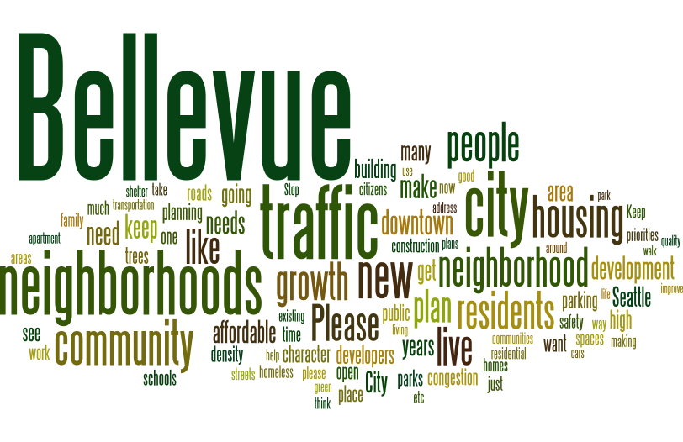
What will be in the plans?
Community profile
Opportunities map
Relationship to Comprehensive Plan
Vision and strategies
Notes:
Concise, clear, strategic, graphics and images

Slide 10
Community Profile
sample
Notes:
Community profile – provides key information about the neighborhood area; would like it to be graphic and easy to absorb without a lot of reading

Slide 11
Opportunities Map
-Assets
-Strengths
-Opportunities
-Distinctive features
-Issues
-Assets
-Strengths
-Opportunities
-Distinctive features
-Issues
-Assets
-Strengths
-Opportunities
-Distinctive features
-Issues
-Assets
-Strengths
-Opportunities
-Distinctive features
-Issues
sample
-Assets
-Strengths
-Opportunities
-Distinctive features
-Issues
-Assets
-Strengths
-Opportunities
-Distinctive features
-Issues
-Assets
-Strengths
-Opportunities
-Distinctive features
-Issues
Notes:
Opportunities map – will be a map spread in the plan that will include call out boxes showing geographically where people have identified opportunities and issues/concerns. Will develop in the Discovery phase of the project

Slide 12
Relationship to Comprehensive Plan
Comprehensive Plan guidance | How does this relate to the neighborhood? | Neighborhood area strategies and actions
Land Use
Residential policies seek to maintain stability and vitality of neighborhoods; promote small-scale activity areas that provide informal meeting places; support neighborhood efforts to maintain and enhance character; help communities maintain local distinctive character while recognizing evolution over time. | Interest in preserving neighborhood character Interest in considering how to create more informal meeting places | Develop neighborhood-based tool bank, skills bank to support home maintenance Identify possible informal gathering places and options for future implementation
Environment
Policies that protect and enhance natural resources; reducing air and noise pollution; set tree canopy goal; address minimizing impacts on the environment through green building and curtailing waste. | Interest in preserving existing trees and increasing tree canopy Interest in neighborhood stewardship of natural areas Interest in expanded participation in recycling and composting | Create a neighborhood based program to support future tree inventory, management and planting Develop a local program for waste reduction Promote native vegetation planting through education and events
sample
Notes:
Comprehensive plan – short piece on how neighborhood interests and priorities relate to the Comprehensive Plan – matrix that will help focus on the relationship and guidance provided

Slide 13
Vision and Strategies
sample
Notes:
Vision and strategies –
Vision
Each strategy – a short description, related CP plan policies, specific actions, lead and partners for actions, neighborhood priority, examples/case studies to help illustrate the strategy

Slide 14
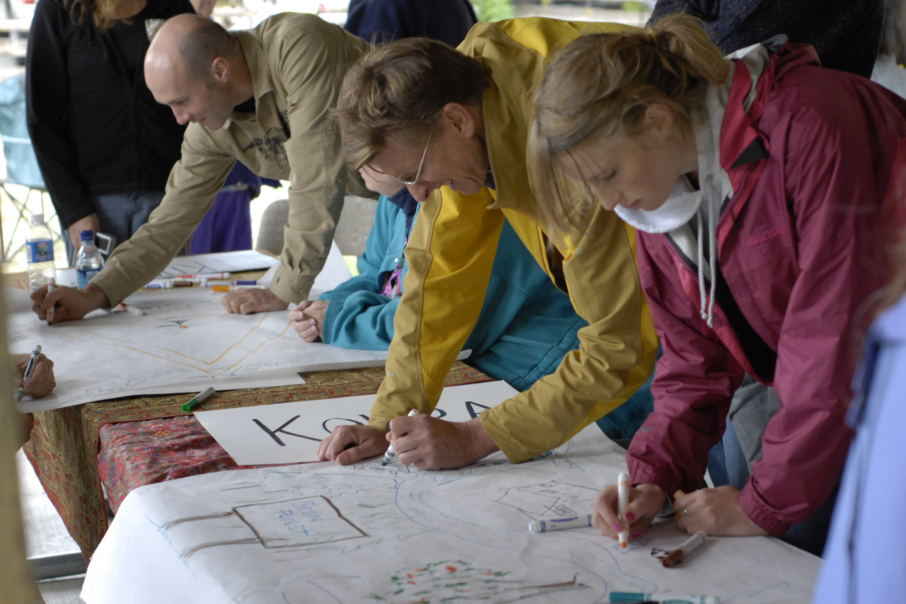
Neighborhood plans:
proposed to be completed in a
one-year time frame
Notes:
Given that this is going to be very much a citizen driven program, important to keep our ask of people’s time reasonable while at the same time providing enough time so that there is space and room for meaningful conversation
One year time frame
Requires organization and structured work program

Slide 15
Work Program
Notes:
Two neighborhood areas at the same time
One year planning process
Follow school-year schedule
Discovery – hear more about what is important to the neighborhood; two way conversation – chance for city stakeholders to talk about important priorities
In-person meetings, walks, photography, online forums
Result in the opportunities map that I mentioned earlier
Develop and refine initiatives – roll up sleeves work sessions to turn preliminary ideas into more developed strategies and actions
Meetings, online forums
Tactical urbanism project
Review and validation – confirm understandings, resolve outstanding issues, achieve agreement on strategies
In-person and online communication
Achieve recommendation from the whole

Slide 16
Neighborhood plans:
will be based on and part of
our Comprehensive Plan
Notes:
Guidance in our Neighborhoods Element for neighborhood area plans and citywide guidance major functions of the city – land use, housing, transportation, capital facilities, utilities, human services, parks and community services,
Part of the Comprehensive Plan – Volume 2

Slide 17
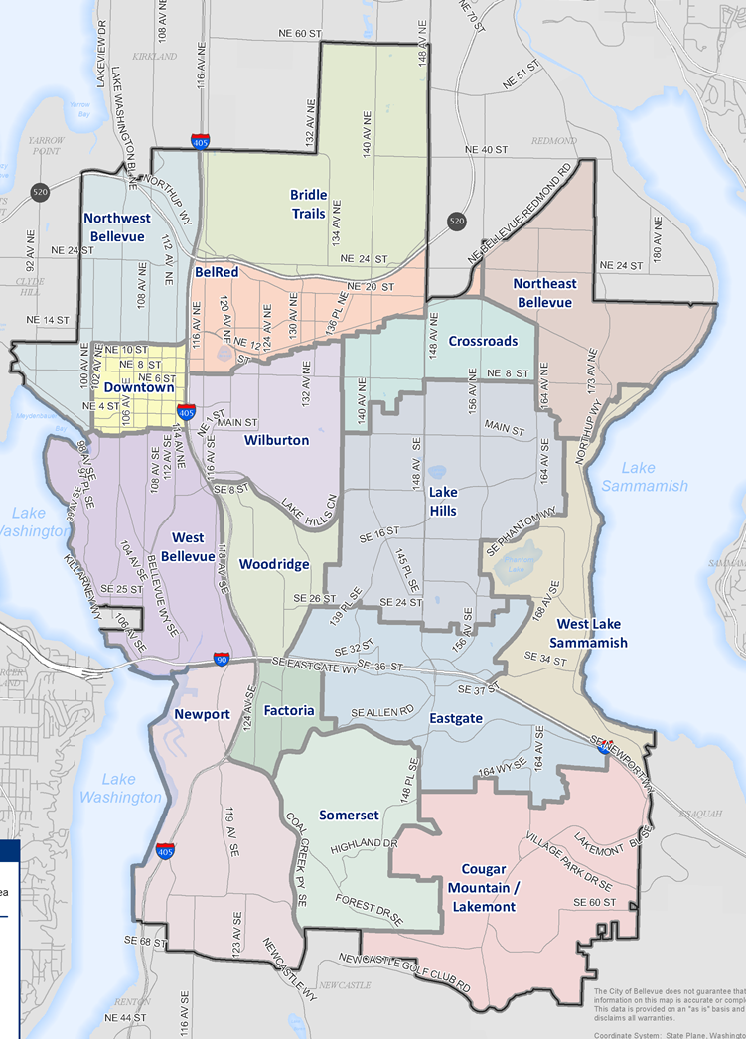
Neighborhoods Element
Establishes 16 neighborhood areas
Articulate vision
Strategies for adapting to change while preserving what is valued
Notes:
Neighborhoods Element adopted in 2015 as part of the last major cp update
Intent was twofold:
Better align neighborhood area boundaries with how people perceive their neighborhoods and to recognize topography and arterials
Policies and direction that creates a pathway to help neighborhoods envision their future and plan strategies that will help each neighborhood adapt to change while preserving what is valued

Slide 18
Relationship to
Comprehensive Plan
Comprehensive Plan
Volume 1
Neighborhood Area Plans
CP Volume 2
Land Use Regulations
Notes:
Will be consistent with the City’s adopted policies and regulations
Means that we will not be making major land use, transportation or other changes that would not be consistent with adopted citywide policy
Will not be changing land use designations, arterial designations
Example
tree preservation – stewardship programs, inventory
We will be reviewing the existing plans to identify outdated information and redundant policies

Slide 19
Outcomes
Priorities and initiatives
Neighborhood-based actions
Inform future Comprehensive Plan updates
Sense of ownership
Notes:
Outcomes
Tangible – neighborhood area plan – that informs priorities and neighborhood scale actions that will achieve the goal of adapting to change and maintaining what is valued
Intangible – will have gathered a lot of information some of which may not be appropriate for the neighborhood plan, but has value for the future comp plan, other departments,
Sense of relevance/ownership in the neighborhood

Slide 20
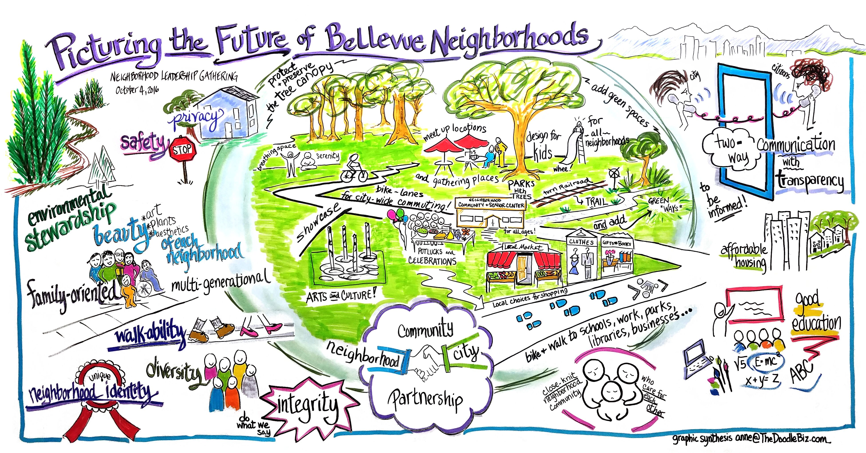
How will we know if we are successful?
Updated plans are relevant to neighborhoods and city
Neighborhood Character
Adaptability
Social Connectivity
Core Needs
High community ownership

Slide 21
Next steps
Report back to Council
Ask for direction for next steps

Slide 22
Neighborhood Area Planning
https://planning.bellevuewa.gov/cms/One.aspx?portalId=5588402&pageId=13046246

